Slide 1
Getting Ready For High School:
Tribulations, Tips, and Troubleshooting for Parents
Presented by – Jill Adams, Monya Crow, Kelly Hemenway, Natalie Melton

Slide 2
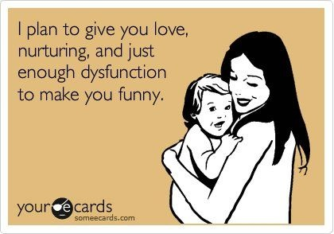
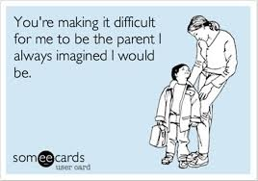

Slide 3
How do you parent?
Helicopter
“I got it, I got it!!”
Drill Sergeant
“My way or the highway…”
Collaborative
“What do you think?”
Notes:
Lens through which you parent, 3 kinds, what is effective?

Slide 4
Phrases that kids ignore
“If you would have just listened to me!”
“You don’t have it so bad!”
“How many times do I have to tell you??”
“You will not…”
“You always…… you never….!!”
“You just…..”
“You have nothing to be stressed about!”
“When I was a kid…..”
“It’s my way or the highway”
“As long as you’re under my roof…”

Slide 5
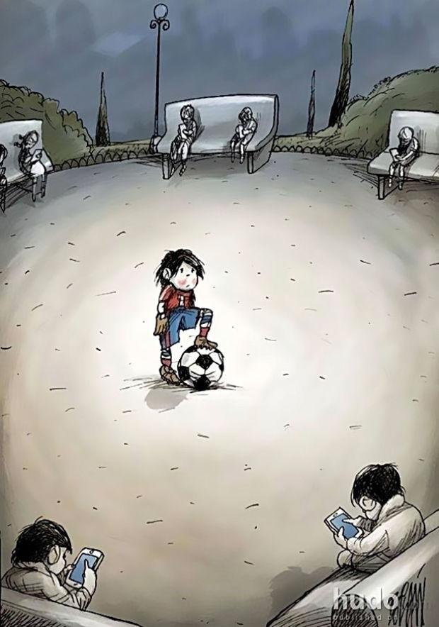
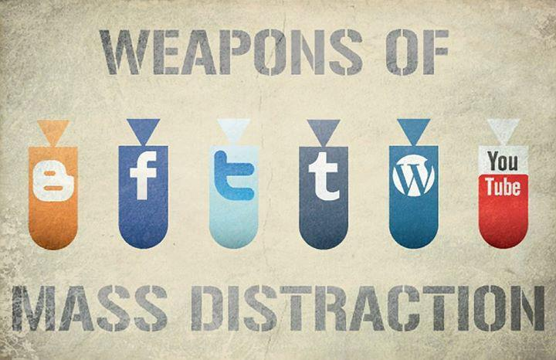
The way I was raised….
THEN VS. NOW
Technology and relationships
Information overload
Instant Gratification
Access to information
Notes:
Remiss if we don’t address that times are different as much as we may not want to admit...their access to information gives them more opinions and voice

Slide 6
Real world examples
Talk about it before it comes up…..
Riding in cars with friends
Curfew
Drugs/Drug Testing
Parties
Parents home?
Laws about alcohol
Safe rides home
Dating rules
Identify go-to adults
Family time vs. Friend time
Grade expectations
Getting a job
Notes:
Be proactive and have conversations prior--too hard to make decisions or have a conversation in the “heat” of the moment

Slide 7
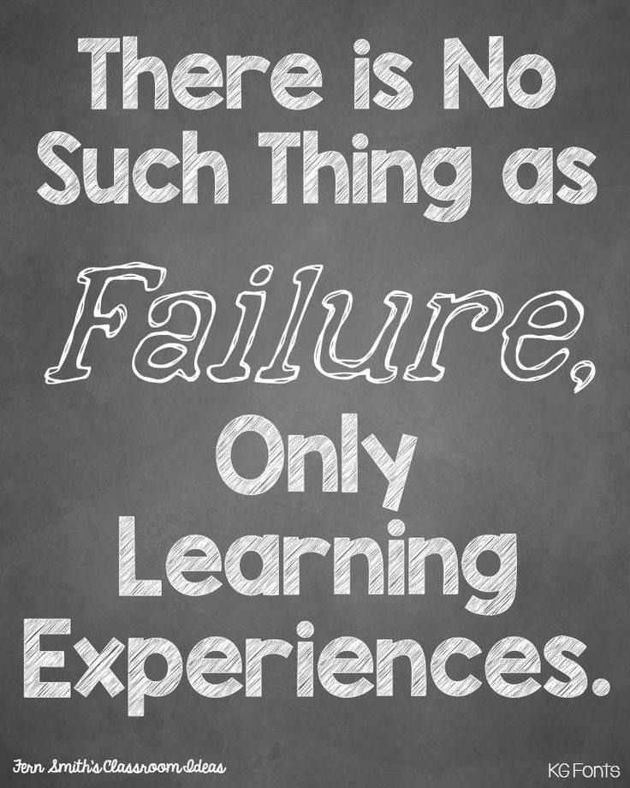
Boundaries and Protective Factors
Supporting our kids! Keeping them safe! Teaching them how to be problem-solvers!
What are some healthy protective factors?
Communication
Consistency
Collaboration

Slide 8
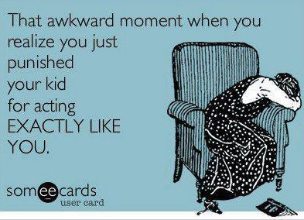
Communication
Strategies
Instill and model healthy coping skills
Kids often handle things the way they see us handle things. “How do I handle a bad day?”
Let them talk!!
“If we don’t listen to the small things, they won’t tell us the big things.”
Empathic statements - huge impact!
Talk about the problem when it’s not a problem.
How do we “make things right?”
Effects
Deepens relationship
Shows them healthy interactions
Identifies you as a “go-to” person

Slide 9
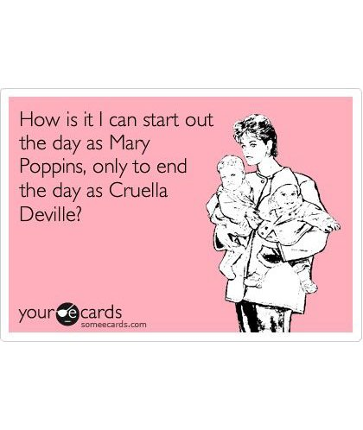
Consistency
Strategies
Do what you say and say what you do.
“Be ready and willing to act on what you say.”
Set limits and stick to them.
If our kids know how to push past the limit we set, they WILL!
“Please, please, please… come one… you never let me….. just this once……”
“I don’t make decisions in the moment.”
Admitting that “we can’t MAKE them…..”
Shared control
Effects
Decreases hitting the boiling point
Avoids feelings of powerlessness

Slide 10
Examples of Shared Control
The idea of shared control is that I have control over what I will do and say and you have control over what you do (behaviorally) and say.
In each of these statements there is a part the parent controls and a part the child controls. - SHARED
“Feel free to go _______ as soon as your homework is done.” (parent has control, child has control)
“People who ________ are welcome to borrow the game controller from me.”
“I give money to those who have ______________”
“I listen to people who don’t yell at me.”
“I will listen when your voice is as calm as mine.”

Slide 11
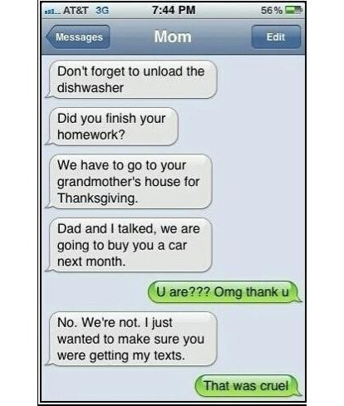
Collaboration
Strategies
Problem solve WITH them, not for them or at them.
Give them the chance to solve it.
“I’m here to support you. Let’s talk about your thoughts on what to do.”
Carve out the time to talk daily
Face to face, text “check in”, follow ups
“Remember last week when we were talking..”
“I’ve thought a lot about what you said.”
Effects
Provides messages of worth and strength
Develops problem solving skills
Develops a healthy ability to cope with disappointment and failure

Slide 12
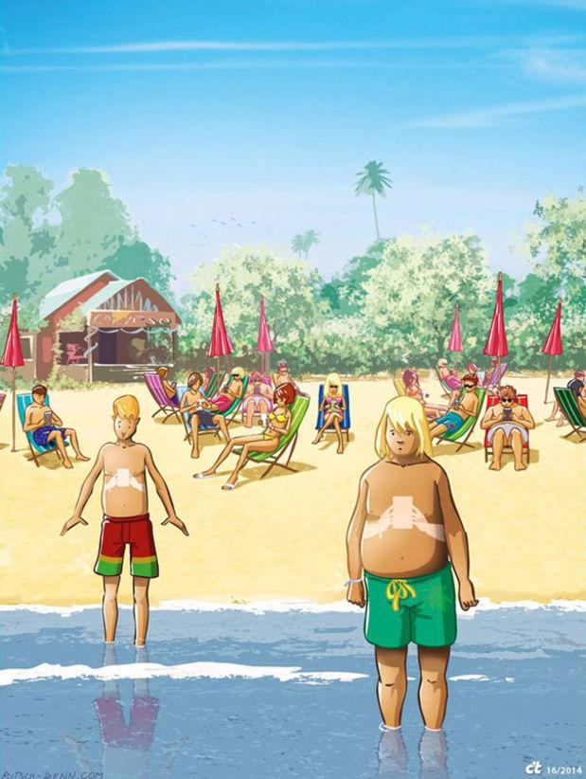
Technology/iPads
Screen Time - anything with a screen
Limits
Technology curfew
Family technology rules
Contracts/agreements
Balance
Downtime
Modeling good technology practices
“Mom put the phone down!”
Technology together
Make time to participate with your child
District issued iPads but parents’ rules!
https://www.youtube.com/watch?v=OINa46HeWg8

Slide 13
Healthy Relationships
Teaching kids HOW vs Telling them WHO:
Friend Choices & Dating Relationships
“What are three things you think make a healthy friendship? What about a healthy dating relationship?”
“How will you know if you are being respected? Giving respect?”
“How will you know if your friendship/dating relationship is unhealthy? What will you do?”
Social Media
Continue to monitor
“Frenemies” online
Bullying vs conflict
District protocols

Slide 14
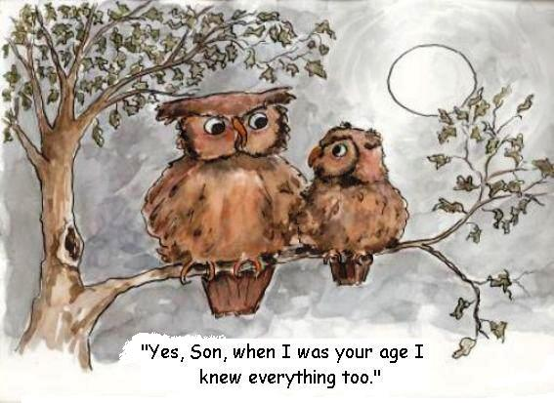
Final Thoughts
“Be kind, for everyone you meet is fighting a hard battle.” - Plato
“It takes a village…..we are in this together.”
What we DO know
Normal thought - “What does my child’s behavior mean about me?”
They get to make choices
Doing the best we can
Ebbs and flows in parent/child relationships
Keep “coming back to the table” with your child.
“I’ve noticed that we keep struggling with _________. What do you think we can do to work through it?”
Nothing works ALL the time, adjust with your child.
Reach out!
Who is your safe person/people?
Child’s counselor
Community resources

Slide 15
Resources
Websites
Parenting http://www.parenting.org
Love and Logic http://www.loveandlogic.com
Family Tech Tips http://mediatechparenting.net/contracts-and-agreements/
AHA Parenting http://www.ahaparenting.com
Kids Health http://www.kidshealth.org
Mental Health America http://www.mentalhealthamerica.net
Bullying http://www.stopbullying.gov
Cybersafety http://www.netsmartz.org
Character http://www.goodcharacter.com
Test Taking Tips http://www2.ed.gov/pubs/parents/TestTaking/index.html

Slide 16
Contact information
Jill Adams M.Ed., CSC
Marcus High School Counselor
Adamsjh@lisd.net
Jill Adams has been a school counselor in LISD for 9 years and is currently a counselor at Marcus High School. Jill’s passion for parent education has served parents in our district through Love & Logic classes, Middle School Parent University and the Marcus High School PEP. Her belief that knowledge is power works to create a collaboration between all stakeholders and promote community and parent involvement in our children’s lives.
Monya Crow M.Ed., CSC, LPC-S
CHOICES Coordinator
Crowm@lisd.net
Monya Crow graduated with a Masters in Counseling from Tarleton State University and went on to obtain her LPC-S. She supervises counseling interns working toward licensure. She worked in and completed her practicum in a residential treatment setting with children aged 5-17. Monya has spent the last 10 years working as a crisis counselor for two school districts as well as in private practice working with children, teens and families. Monya is currently the Coordinator for the LISD CHOICES program, which supports a variety of prevention, and intervention programs district wide with a focus on social and emotional health in students.

Slide 17
Drug Trends
Sgt. Colin Sullivan, Flower Mound PD
Colin Sullivan, a Sergeant with the Flower Mound Police Department graduated from Univ. of North Texas and has been working in the field of law enforcement for last 24 years. He is currently assigned to the Investigative Services Division which oversees all Detectives, SRO's (School Resource Officers), and the Narcotics Unit. Sgt. Sullivan is a graduate of the Bill Blackwood Leadership Command College, holds a Master Peace Officer Certification, and is licensed TCOLE Instructor. When it comes to illegal drugs, Sgt. Sullivan has been on the front lines of both prevention and enforcement since 1991. His message has always been clear....."You can't arrest your way out of the drug problem. The solution lies with the family".
“Drug Trends- Drugs are unfortunately in every district and LISD is not the exception. As a result parents, teachers, and business owners alike need to be aware of the drugs trending through our neighborhoods and businesses. We can only act if we know what to look for!” - Sgt. Colin Sullivan Flower Mound PD

